Slide 1
CSE428: image processing
MILESTONE 01 PRESENTATION

Slide 2
Table of contents
Page 03: Objective
04: Dataset
06: Dataset Distribution
10: Logistic Regression
13: Neural Network
16: Results and Comparisons

Slide 3
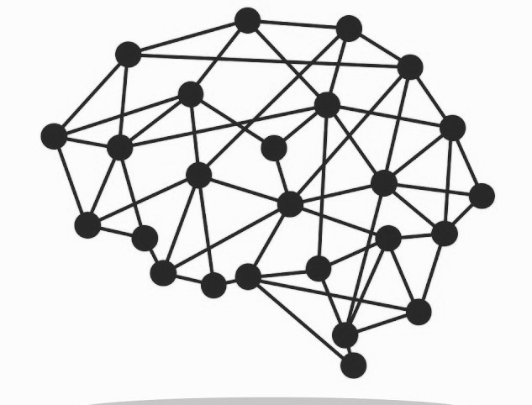
Objective
Our goal for Milestone 01 is to analyze the image dataset and train our Logistic Regression and Neural Network Models and compare their test results.

Slide 4
Dataset
We have taken our image dataset and converted it into csv (comma separated values) format so that we can implement our Machine Learning models and interpret the results.
Dataset Size : 2150 images (Train)
250 images (Test)
Image Shape : 64x64x3
There are separate batches of data for Train and Test.

Slide 5
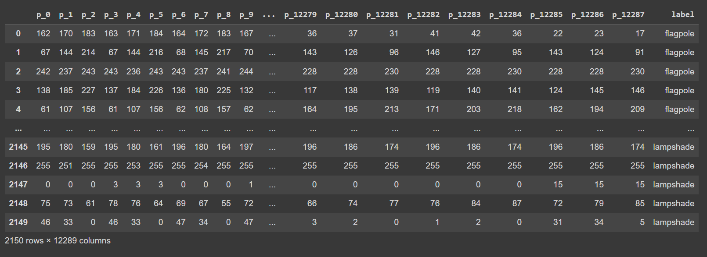
Snippet of our Dataset

Slide 6
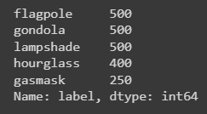
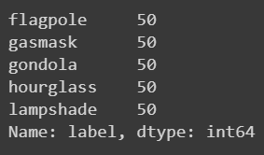
Dataset Distribution (1)
Training Set:
We have 5 different classes in our dataset. They are as follows:
flagpole
gasmask
gondola
hourglass
lampshade
Test Set:

Slide 7
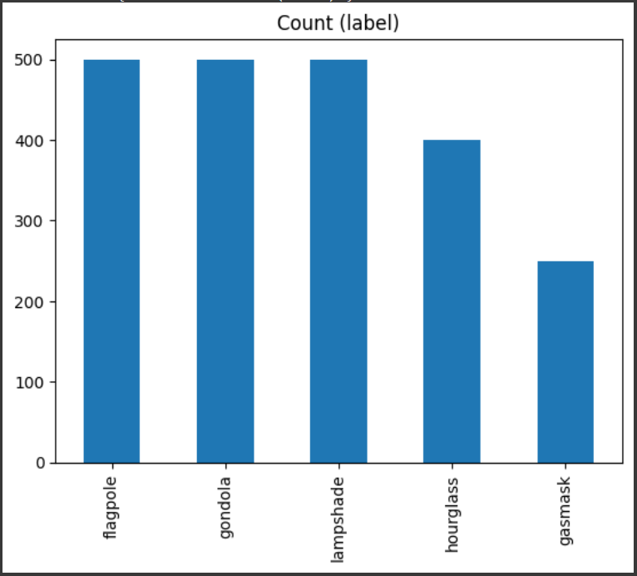
Dataset Distribution (2)
Here, we can see our training dataset is unbalanced because all of the classes do not have equal number of instances.

Slide 8
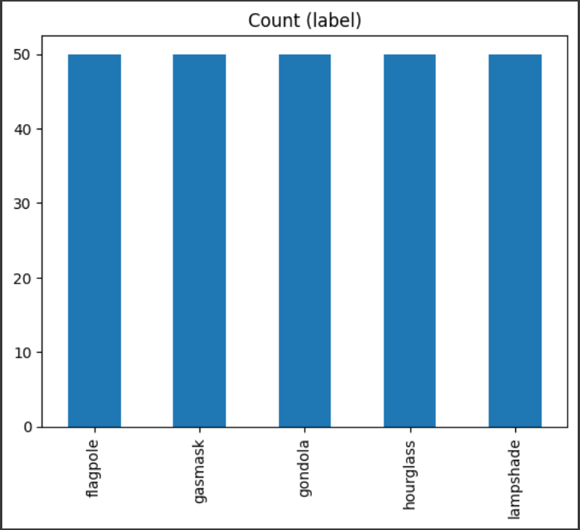
Dataset Distribution (3)
Here, we can see our test dataset is balanced because all of the classes have equal number of instances.

Slide 9
Unbalanced Distribution
In one of the previous slides, we saw that for our training set, our distribution was unbalanced. This is actually an issue that must be addressed. We can use one of the following techniques to tackle it:
Resampling
Synthetic Data Generation
Weighted Loss Function
Transfer Learning
Anomaly Detection
Cluster-Based Method.

Slide 10
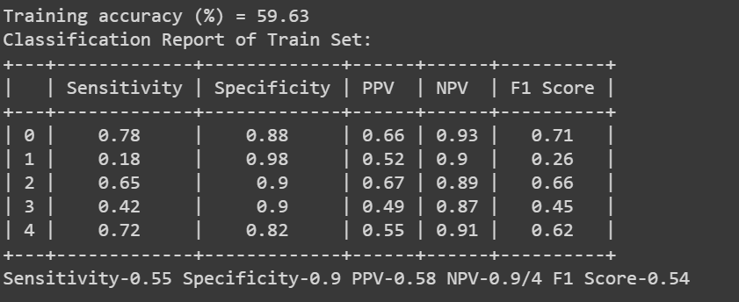
Logistic Regression
Upon implementing Logistic Regression Model on our training set, we achieved the results as shown in the classification report, here.

Slide 11
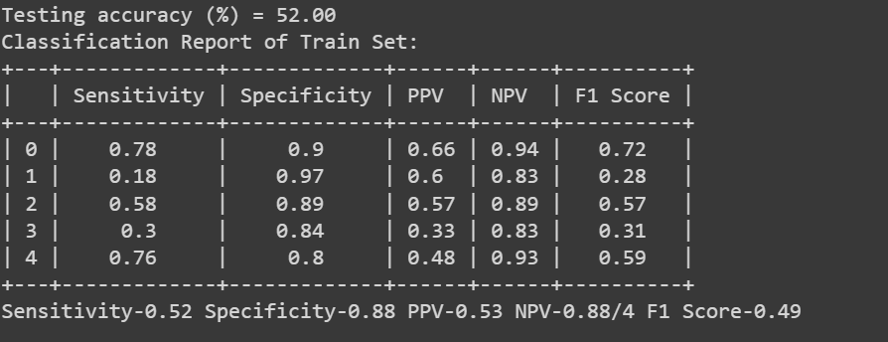
Logistic Regression
Upon implementing Logistic Regression Model on our test set, we achieved the results as shown in the classification report, here.

Slide 12
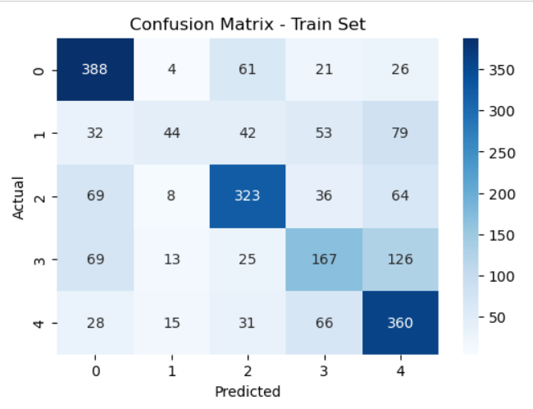
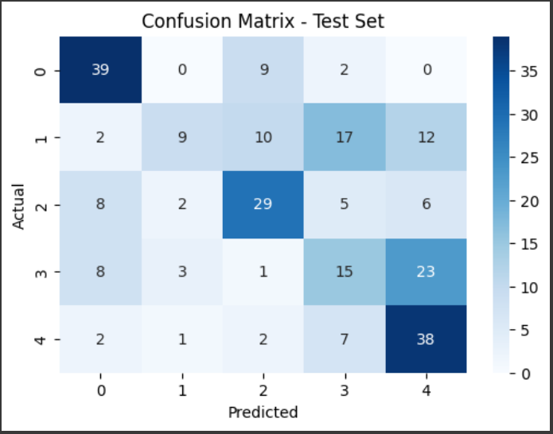
Confusion Matrices

Slide 13
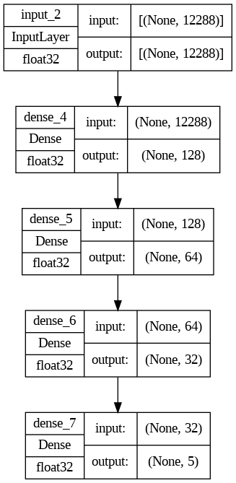
Neural Network
We have trained a five layer Neural Network model where input and output (softmax) is of one layer each and 3 hidden layers with logistic activation functions. The resulting model looks like the plot shown here. We have used Gradient Descent for optimizing our model. We have used logistic activation function and takes any real value as input and outputs values in the range of 0 to 1.

Slide 14
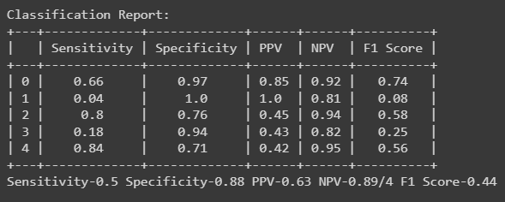
Neural Network
Upon implementing Neural Network Model on our test set, we achieved the results as shown in the classification report, here.

Slide 15
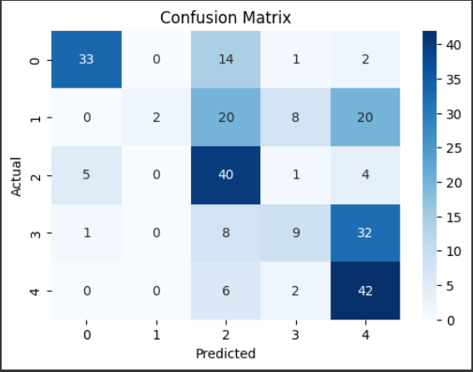
Confusion Matrix

Slide 16
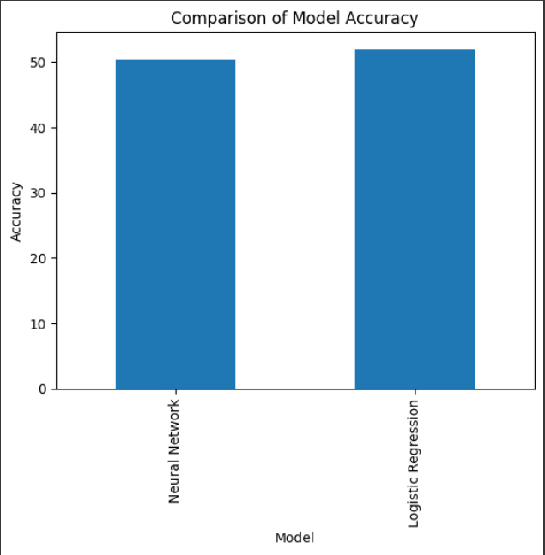
Results and Comparisons
After training and testing both models, we observed that the accuracy for the Logistic Regression Model was 52.00% and for the Neural Network Model, it was 50.40%. We will see further comparisons in the resultant metrics in the following slide.

Slide 17
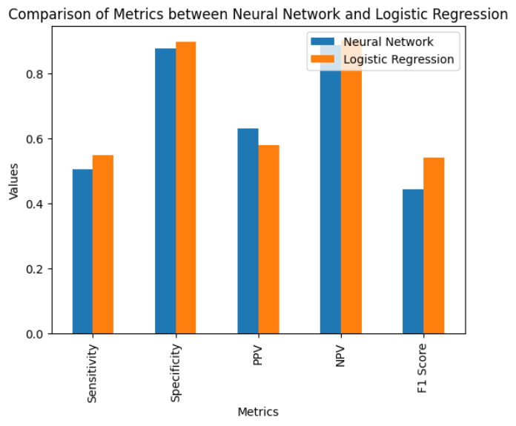
Results and Comparisons
Here, we can observe the differences between the Sensitivity, Specificity, PPV, NPV and F1 Score for both models.

Slide 18
Thank you!
Hope you liked our presentation. Please ask if you have any questions.

